Slide 1
Political Institutions--systems

Slide 2
Branches/powers of government
Legislative
Executive
judicial

Slide 3
Parliamentary system
Executive selected (and removed) by parliament—prime minister
Voting blocks are usually a single party or coalition of parties
Supremacy of legislative institution
NOT separated powers (legislative and executive)
Opposition forms “shadow” government in UK
Separate Head of State

Slide 4
Parliamentary system checks & balances
Parliament can censure cabinet ministers
Parliament can refuse to pass legislation
Question the executive and cabinet ministers
Impose time deadlines on calling new elections
Vote of no confidence in prime minister (can be followed by new elections)
Head of state can return a law to parliament, but no “veto” power
Government can be changed at any time (more immediate response to people?!)

Slide 5
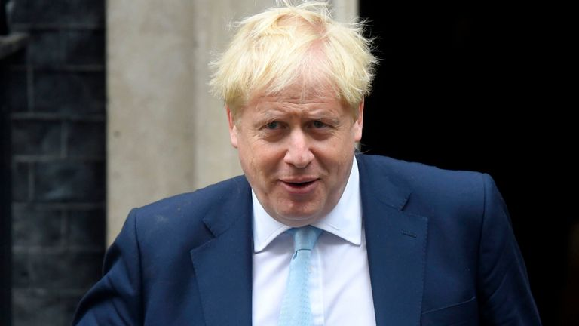
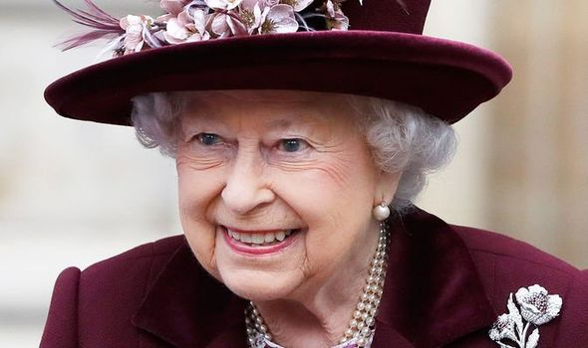
Britain

Slide 6
Presidential system
Separation of executive and legislative powers
President is Head of Government AND Head of State
President separate from legislature and can make own decisions….
Elected directly by the people
Cabinet/ministers responsible to executive

Slide 7
Presidential system checks and balances
Executive can veto legislation
Legislature can override a veto
Courts can declare laws unconstitutional/illegal (judicial review)
President appoints judges
Legislature confirms judicial appointees
Legislature confirms executive ministers/cabinet members
Legislature can impeach executive, cabinet and judicial

Slide 8
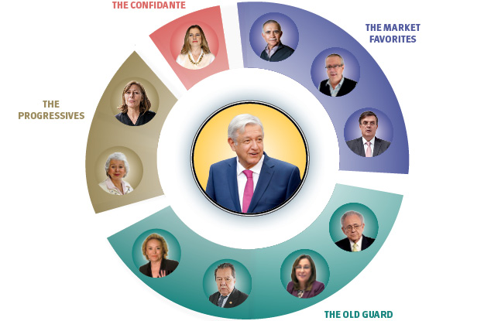
Mexico’s presidential system—fixed term president, cabinet responsible to executive

Slide 9
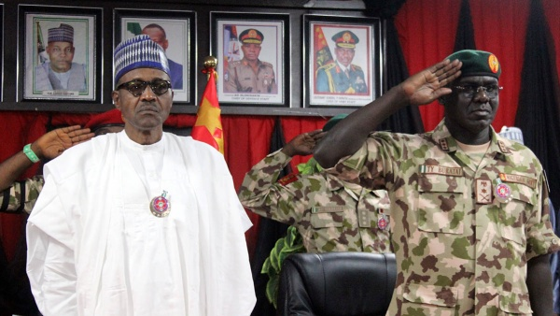
Nigeria’s president is head of government, state and commander-in-chief of military

Slide 10
Semi-presidential system
Both prime minister and president (Dual executive system)
Prime minister is head of government
President is head of state
President directly elected by people
President in charge of foreign affairs (military, treaties, etc)
Cabinet is responsible to legislature, not executive

Slide 11
Semi-presidential system checks and balances
President chooses prime minister, legislature approves prime minister
President can dismiss prime minister
Executive functions taken away from president (cover? Shared powers?)
Legislature can remove prime minister with no confidence vote
Confusion over who is responsible for policies

Slide 12
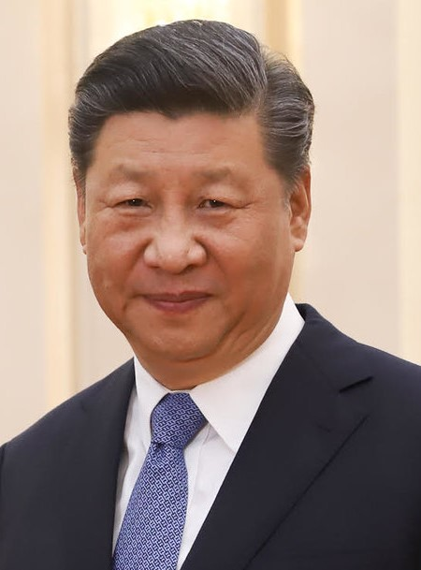
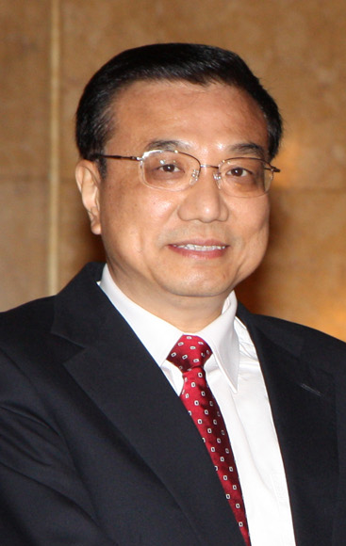
China’s president serves as commander in chief, and General Secretary of the CCP, nominates the premier of CCP, who serves as head of government/premier/prime minister.
Xi Jinping
Li Keqiang

Slide 13
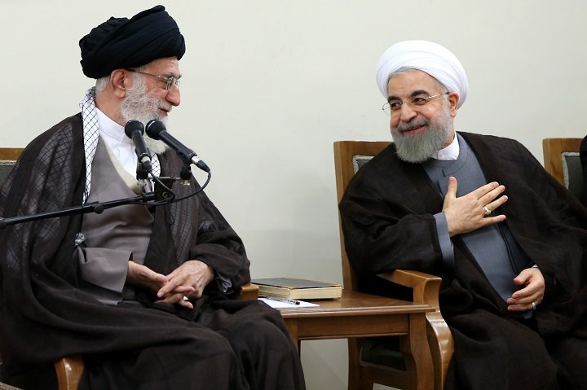
Iran’s Supreme Leader is commander in chief, sets political agenda, appoints top ministers and councils while the President conducts foreign policy and overseas civil service

Slide 14
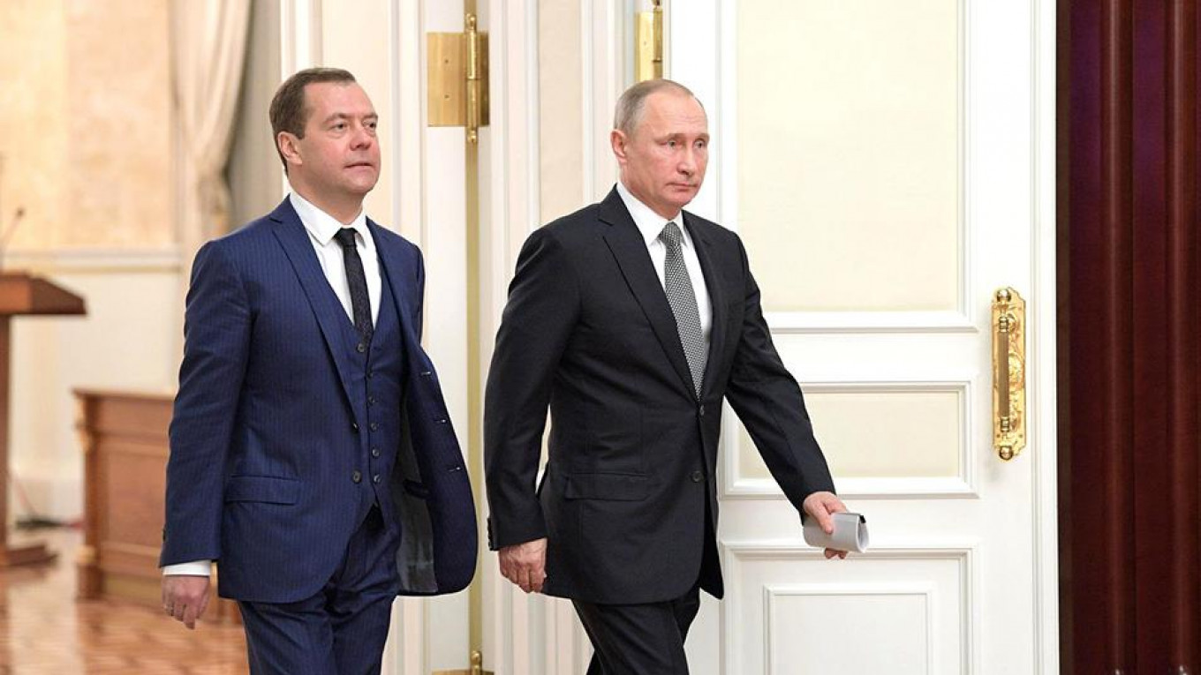
Russia’s Prime Minister is head of government, President is commander in chief, head of state, foreign policy, appoints ministers

Slide 15
Who has more power-a prime minister or a president?

